Slide 1
Suggestion of a New Framework of DAMPE offline software
Chi WANG (chiwang@mail.ustc.edu.cn)
Guangshun HUANG (hgs@ustc.edu.cn)
On behalf of ustc-group
2014-05-12

Slide 2
Software of HEP experiments
Online
  DAQ
  Trigger
  etc.
Offline software of DAMPE
  Reconstruction
  Analysis
  Simulation
  Calibration
  etc.
Framework should be an effective system:
For developer
  Clear and simple structure(High readability)
  Decoupling modules
  High extensibility (easy to add new things into it)
For user
  Simple and convenient to use
  Fully configurable job

Slide 3
Contents
Used tools
Basic architecture
  Structure
  DmpCore
Algorithm and service
  Example of a concrete algorithm
Fully configurable job
  How does it run?
  Setting options at runtime
Extensibility
  Create new algorithm or service
  Create new event class
Installation and setting up
How to work based on current version?
Summary

Slide 4
Used tools of DAMPE offline software
Languages
  C++
    Functional packages, effective
  Python
    User interface, flexible
  Bash
    Global configuration (setup environment)
    Some commands
External software
  Root
  Geant4
  SCons
    Compilation method
External libraries
  Boost.python
    Used to link C++ and Python
  Boost.filesystem
  CLHEP
C++ code
Python binding code
libDmp*.so
Compile all packages as shared libraries

Slide 5
Basic architecture
Kernel
DmpCore
Create a singleton of DmpCore --- gCore
gCore manages all managers
Service Manager
Algorithm Manager
Other Managers
A manager will control a serial same type concrete classes
DmpVSvc
DmpVAlg
Other abstract base class
Anyone could focus on their concrete class (inherit from DmpV*)
will not affect works of the others
convenient to debug and ingrate it into DMPSW later.
DmpConcretSvc
DmpConcretAlg

Slide 6
Basic architecture
Adopted concepts from Gaudi and Sniper: algorithm, service
  algorithm: concrete data process performed on each event
  service: common work for all users, such as data I/O, etc.
dependency
generalization
composition
aggregation
User has right to extend algorithm and service,
DmpCore could recognize and drive them once they are registered in job option files dynamically.

Slide 7
Algorithm and service
They are classes to finish one certain function. Difference: process performed on each event?
DmpAlgorithm(Service)Manager manipulates all user’s (or default) algorithms (services) once they are registered into manager as specified in job option file.
Concrete algorithm: (User focus on how to process one event)
Impliment bool ProcessThisEvent()
Get needed service in bool Initialize()
  because ProcessThisEvent() has not argument
  fetch all needed services through the global pointer gCore
Concrete service:
Each service has a unique name
  So, user could get it from service manager
Decoupling from algorithm
  Since algorithm may have many implementation,
  For instance, Rdc for BT2012 and Rdc for prototype

Slide 8
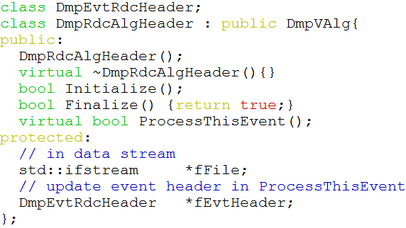
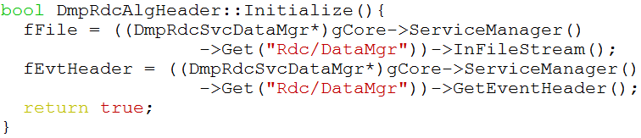
Example of a concrete algorithm

Slide 9
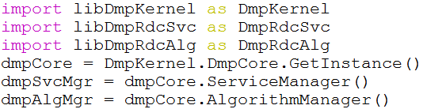
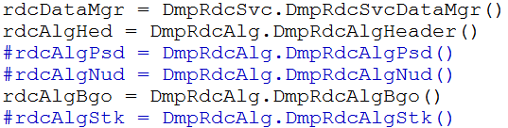


Job option files (python script)
1. Import needed libraries
We can use those classes and methods in
python script, since we bind them by using boost.python
2. Create algorithms and services
Create whatever you need and append them into DmpCore
DmpCore only manipulates those algorithms and services which are explicitly appended into managers
3. Register them into DmpCore
Strict order of execution of all appended Alg.
as the order of appending
4. Run this job
Optimizing this part. Better as: dmpCore.Run()

Slide 10
How are the algorithms booted?
DmpCore::Initialize()
invoke Initialize() of all concrete services which are in DmpServiceManager,
then, invoke all Initialize() of all concrete alg. which are in DmpAlgorithmManager
DmpCore::Run()
* Event loop,
(how many envet?
DmpCore::fMaxEventNo)
* Execute all algorithms
in DmpAlgorithmManager
Algorithm 1
Communicate by
event classes
Data
Buffer
Algorithm 2
Algorithm 3
DmpCore::Finalize()
invoke all Finalize() of all alg. in DmpAlgorithmManager,
then, call Finalize () of all services in DmpServiceManager

Slide 11
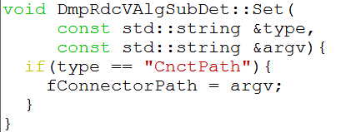
Setting options at runtime
Convenience for users to set options in job option files
concrete algorithm inherit from DmpVAlg which in Kernel package
already band void DmpVAlg::Set(std::string type, std::string argv)
All concrete Alg. classes of each
Subdetector could use it in job option files
As below:
This method has also been used for DmpVSvc and its all concrete classes.

Slide 12
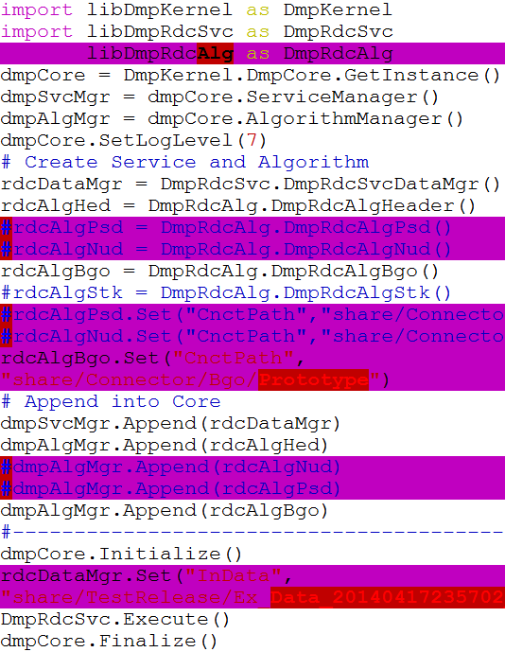
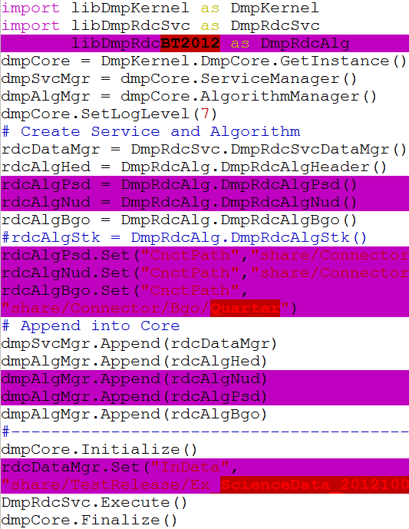
Extensibility -- create a new algorithm
libDmpRdcAlg VS libDmpRdcBT2012. Only convert algorithms are different:
Default algorithms of Rdc
prototype (2014)
Extended algorithms of Rdc
Beam Test (2012)
How to create a new alg.?
1. Create a new package by
using the command:
dmpNewAlg (after installation)
-- will create the template for you
Binding file, and
SConstruct file
2. Implement your code
3. Compile it
* will compile all *.cc filein src ,
* and install the created lib. into $DMPSWWORK
Service takes the same strategy

Slide 13
Extensibility -- create new event class
Why we need new event classes?
Algorithms communicate by event classes
We can NOT design all algorithms at this time
Reserve data members for one global event class is NOT a good way!
  can NOT use old root file which was created by old event class
  suppose, we decide to add an new (or delete) data member one day later. We can not use the new event class to read the root files which are created by using the old event class
Communicate by
event classes
Algorithm 1
Data
Buffer
Algorithm 2
Algorithm 3
Do it Step by Step
Many types of event classes, corresponding to different levels of data
Do NOT worry about the higher level event classes, just make sure that the event class of current level is right!

Slide 14
Installation and setting up
Like geant4, only need to install one software(basic libraries and header files) in a server. All users use the same geant4 ($G4INSTALL)
User creates a new G4 simulation, will compile and install the special library of the project into $G4WORKDIR
Kernel of geant4 knows how to load and use the right lib.
Administrator
  Create dictionaries of event classes
    ./pre-install.(c)sh
  Compile and install it
    Scons
All users have their own work area
  Setup environment
    source /prefix/bin/thisdmpsw.(c)sh
Prefix/
$DMPSWSYS
include/
lib/
share/
bin/
thisdmpsw.(c)sh
$HOME/dmpwork
$DMPSWWORK
lib/

Slide 15
How to use it
Setup environment
  source /prefix/bin/thisdmpsw.(c)sh
Working mode:
  Create a algorithm, service, or even event class
    dmpNewAlg (dmpNewSerivce, not finish)
      Create new algorithm and service
    dmpCreateDictionary (generate dictionary of new created event class)
      Create new event class if you really need to do so
  Compile your codes
    Will install users’ library into $DMPSWWORK
  Using your special lib. or default lib. in your job option file

Slide 16
Summary
Prototype of an extensible and flexible framework of DAMPE offline software
  Easy to extend new packages (for developer)
  Easy to use (for user)
Current status
  Kernel (Framework, it’s important. Already has some basic functions)
    DmpCore
    DmpAlgorithmManager and DmpVAlg
    DmpServiceManager and DmpVSvc
    DmpDataBufferManager and DmpVDataBuf (On going, Principle study)
  Event classes (Bgo part is ready, for simulation and Rdc)
  Finised principle study of boost.python (binding kernel is more difficult, but finished. Wrote a template of binding file for others)
  Rdc (Almost done)
  Simulation (Almost done)

Slide 17
Many good suggestions from
  Weidong LI (liwd@ihep.ac.cn)
  Tao LIN (lintao@ihep.ac.cn)
Very grateful for their help!

Slide 18
Backup

Slide 19
Plan
Data buffer
Create dmpEventModule to generate a template of event classes
Optimize DmpCore
  Management
  DmpCore::Run()

Slide 20
Advantages
1. 可拓展性更强
  像DmpVAlg这样的类都是abstract base class, 里面的pure virtual method 就是后续拓展的接口
  将来要增加怎样的XXX(algorithm,service,etc)目前不知道，只要从这些abstract base class 派生出来，都可加载到DmpCore里面去驱动并执行
2. 解耦合（高内聚，低耦合）
  模块之间解耦合
  算法之间解耦合
  算法与数据之间解耦合
3. 整体框架，上层管理
  DmpCore这个类统一管理、驱动所有的执行。设计对DmpCore执行流程是关键
  新增加的算法，要用到什么service和data从DmpCore里面去取（发放的方式不是一个好的方式，因为需要先知道发放给誰，所以应该交给DmpCore去管理，要用什么自己去取）
4. 减少各个developer工作之间的影响 （基于1,2,3）
  在开发具体功能模块的时候，集中精力写对event处理的具体算法
  不关心Dmpcore怎么将它们串接起来，怎么做数据交换
5. 运行时可全配置
  在python脚本中实现对Job的全配置，对所有作业配置流程一致.
  作业运行更方便、灵活
最终目的：
  协同开发DAMPE offline software，更易聚集各子探测器开发
  方便拓展、复用性更大、使用更方便

